Slide 1
History of Display Screens
Leya and Salma

Slide 2
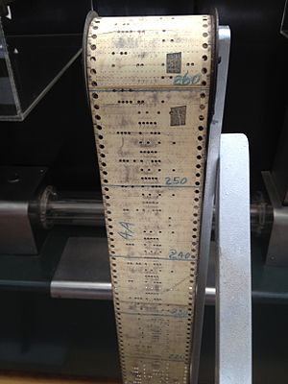
Punch Cards and Paper Tape
Punched tape or perforated paper tape is a form of data storage, consisting of a long strip of paper in which holes are punched to store data.
Text was encoded in several ways. The earliest standard character encoding was Baudot, which dates back to the nineteenth century and had five holes in one punch card
Punch card were the earliest way computers used to store data
Also was a way in the olden days that students taking computer science would run the program once they had there punch cards ready.
This evolve into hard drive data that was stored
The first way to save data

Slide 3
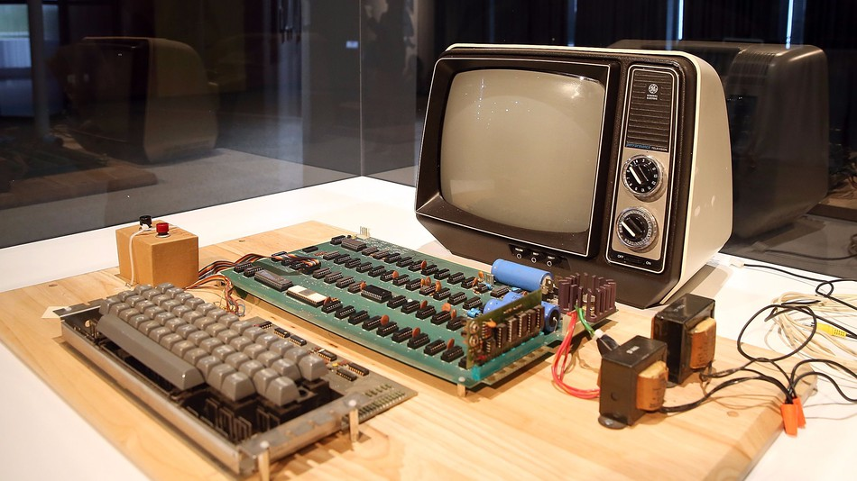
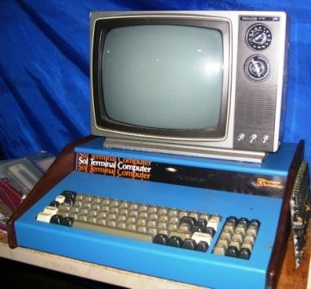
CCTV
In the 1970’s, Steve Wozniak and Lee Felsenstein determined that one could hook CCTV (Closed-circuit television) monitors to a computer and display almost anything.
Wozniak and Felsenstein built these video terminals into computers like the Apple 1 and Sol-20

Slide 4
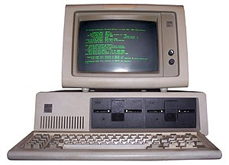
Monochrome Monitor
A monochrome monitor is a type of CRT computer monitor which was very common in the early days of computing, from the 1960s through the 1980s, before color monitors became popular.
The monochrome monitor was just a screen with writing and no graphics.
Mostly and mainly consist of words.
The monitor evolved to have the game space invader.
One of the fist screens that evolved to become the future of computers.
Became the wide spread monitor in the late 19 hundreds.

Slide 5
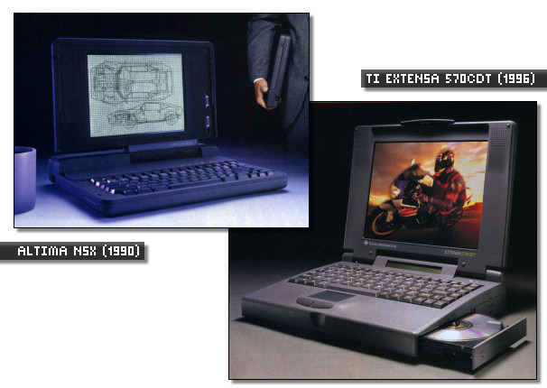
LCD Monitors
LCD (Liquid Crystal Display) Monitors were developed during the 1960s. These displays were energy efficient, thin and inexpensive, but they were hard to read without either back lighting or direct illumination.
In the early 1990s, LCD technology was mainly used in laptops because of their low power consumption, light weight, and small size.

Slide 6
Works Cited
“A history of computer displays.” DigitalRise, 19 Feb. 2016, www.digitalrise.biz/hardware/a-history-of-computer-displays/.
Edwards, Benj. “A Brief History of Computer Displays.” PCWorld, PCWorld, 1 Nov. 2010, www.pcworld.com/article/209224/displays/historic-monitors-slideshow.html#slide17.
“Monochrome monitor.” Wikipedia, Wikimedia Foundation, 28 Feb. 2018, en.wikipedia.org/wiki/Monochrome_monitor.
“What is Monochrome? - Definition from Techopedia.” Techopedia.com, www.techopedia.com/definition/2020/monochrome.

Slide 7
THE END!

